Slide 1

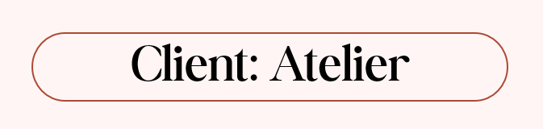
BUSINESS INTELLIGENCE AND BUSINESS ANALYTICS
Team Trident: Chanlin Naicker & Marcio Pereira De Lima & Ya Wai Thone
24 APRIL 2026

Slide 2

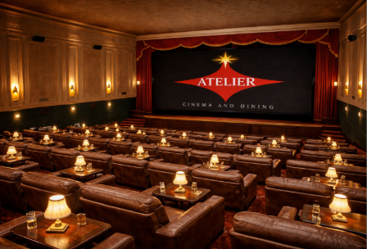
Introduction
and Organisational Overview
A cinema experience, reimagined
Atelier is an independent dine-in cinema that is family-owned and was established in 2018 in Dublin 2. It offers a premium entertainment experience by combining curated film screenings with in-seat dining in an intimate boutique setting.
The cinema was designed as an alternative to the conventional multiplexes.
Atelier is currently experiencing growing competition with streaming platforms and mega movie chains even though it has a unique business model. This has led to a decrease in attendance, customer loyalty and profitability.

Slide 3
KEY BUSINESS PROBLEMS IDENTIFIED:
01
Weak Session Profitability
Methodological
Approach
High variability in occupancy and revenue across screening sessions, with no insight into which films or time slots yield strong returns.
02
Limited Dine-In Sales
Strategic Frameworks Applied
Customers underutilise the dining service, purchasing single items only. The oversized menu also contributes to food wastage and inconsistency.
Porter's Five Forces
03
Disconnected Systems
SWOT Analysis
Ticketing and food ordering operate independently, preventing management from correlating screening demand with food sales and staffing needs.
Gap Analysis
04
Low Customer Retention
Balanced Scorecard
No formal mechanism exists to identify returning customers, reward loyalty or deliver personalised recommendations to drive repeat visits.
05
Lack of Differentiation
The current experience lacks exclusivity and distinction, making Atelier difficult to position uniquely against boutique cinemas and streaming platforms.

Slide 4
Project Objectives + Proposed Solution Overview
Resign the business model through a combined BI and CRM solution
Tableau dashboards to be used for cinema, concession and customer behaviour
Salesforce CRM as a centralised customer management
Targeted campaigns and membership tiers, survey and feedback tracking for service improvement
Better visibility between bookings and food demand
On-Demand menu and scheduling decisions. QR-based menu or preorder support to reduce queue delays
A more differentiated and data-driven cinema experience
Provide management with a more coordinated operational and data driven decision-making process.

Slide 5
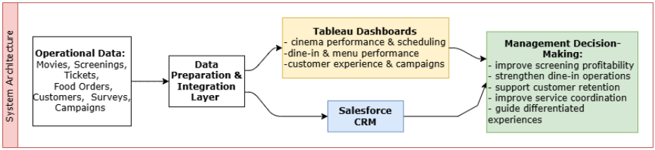
System Overview and Data Model
Database Design:
Cinema Performance
Movies
Screenings
Historical Ticket Sales
Concession Performance
Food Menus
Historical Food Orders
Prospected Food Orders
Customer Relationship
Customer Information
Survey & Feedback
Marketing Campaign
Tableau Dashboards:
Cinema Performance Across Screening Schedule
Concession Current Performance
Concession Prospected Performance
Customer Experience and Marketing Campaign
CRM Integration:
Customer Profile Management
Automated Feedback
Marketing Campaign Automation
Food Suppliers and Inventory
Notes:
This slide shows how our system is structured from data to decision-making.
We start with operational data such as ticket bookings, food orders, and customer data, which are collected across the business.
This data is then prepared and integrated into a structured data model, allowing us to connect different areas like bookings, food sales, and customer behaviour.
From there, the data feeds into Tableau dashboards, where we analyse the main KPIs and reports.
Also, Salesforce acts as the central CRM layer, where we manage customer profiles, automate feedback, and run marketing campaigns.
Together, this creates a connected system that improves operational visibility and supports better decision-making across the business.
Now, we will briefly show how this translates into the dashboard and how management can actually use this data.

Slide 6

Business Impact
KEY GAPS CLOSED
📊 Session Profitability
🍽️ Dine-In Revenue
Tableau Cinema dashboard surfaces underperforming screenings, genres and time slots — enabling data-backed scheduling decisions.
Simplified menu, 3-course dining package and pre-order integration boosted food attachment and reduced per-session waste.
🔗 System Integration
👥 Customer Retention
Booking-to-food pre-order link created a single operational view of demand, enabling proactive kitchen and staffing coordination.
Salesforce CRM drives hyper-personalised campaigns — VIP pre-sales, win-back flows, birthday offers and dietary alerts by tier.
✨ Competitive Differentiation
📦 Stock & Supplier Control
Premium 3-course cinema dining, new cocktail & drinks menu, and a loyalty programme position Atelier as a uniquely distinct experience.
CRM stock visibility enables staff to act on low inventory in real time, reducing waste and ensuring supplier communications are timely.
From fragmented operations to an integrated, data-driven cinema experience

Slide 7
Conclusion and Reflection
Before Implementation
After Implementation
Decreased Profit through years
Concession component of business in crisis
Decentralised System
Poor Performance records
No customers relationship built
Weak competitive advantage
All Data System Integrated
A structured relationship among tickets, concession and customer
CRM Solutions Implemented – better communication
Complete customer communication through their life cycle
Regular Marketing campaigns implemented
New KPIs to drive the business
Interactive Dashboards highlights overall performance
Bar and New Drink Menu
Unique and personalised experiences
Stock control
In a World Full of Content, Shared
Storytelling + Experiences Still Win
Future ?
Cutting-edge Cinema Technology
Interactive Mobile App
Customer Loyalty Program
Food & Beverage Partnerships
Atelier Product Shop

Slide 8
Thank you
Cinema
Curation
Dining

